Slide 1

PROJECT NAME
"Flipkart TV Market Overview: A Data-Driven Study of Pricing, Features, and User Ratings"

Slide 2
About Me
Name : Bathala . Manoj Kumar Reddy
Educational Background : B.Tech(AI&DS)
Year of Graduation : 2021-2025

Slide 3

Problem Statement :
Understanding consumer preferences in the TV market: Analyzing best-selling brands, price segments, and key features to optimize product stocking and maximize sales on Flipkart.

Slide 4
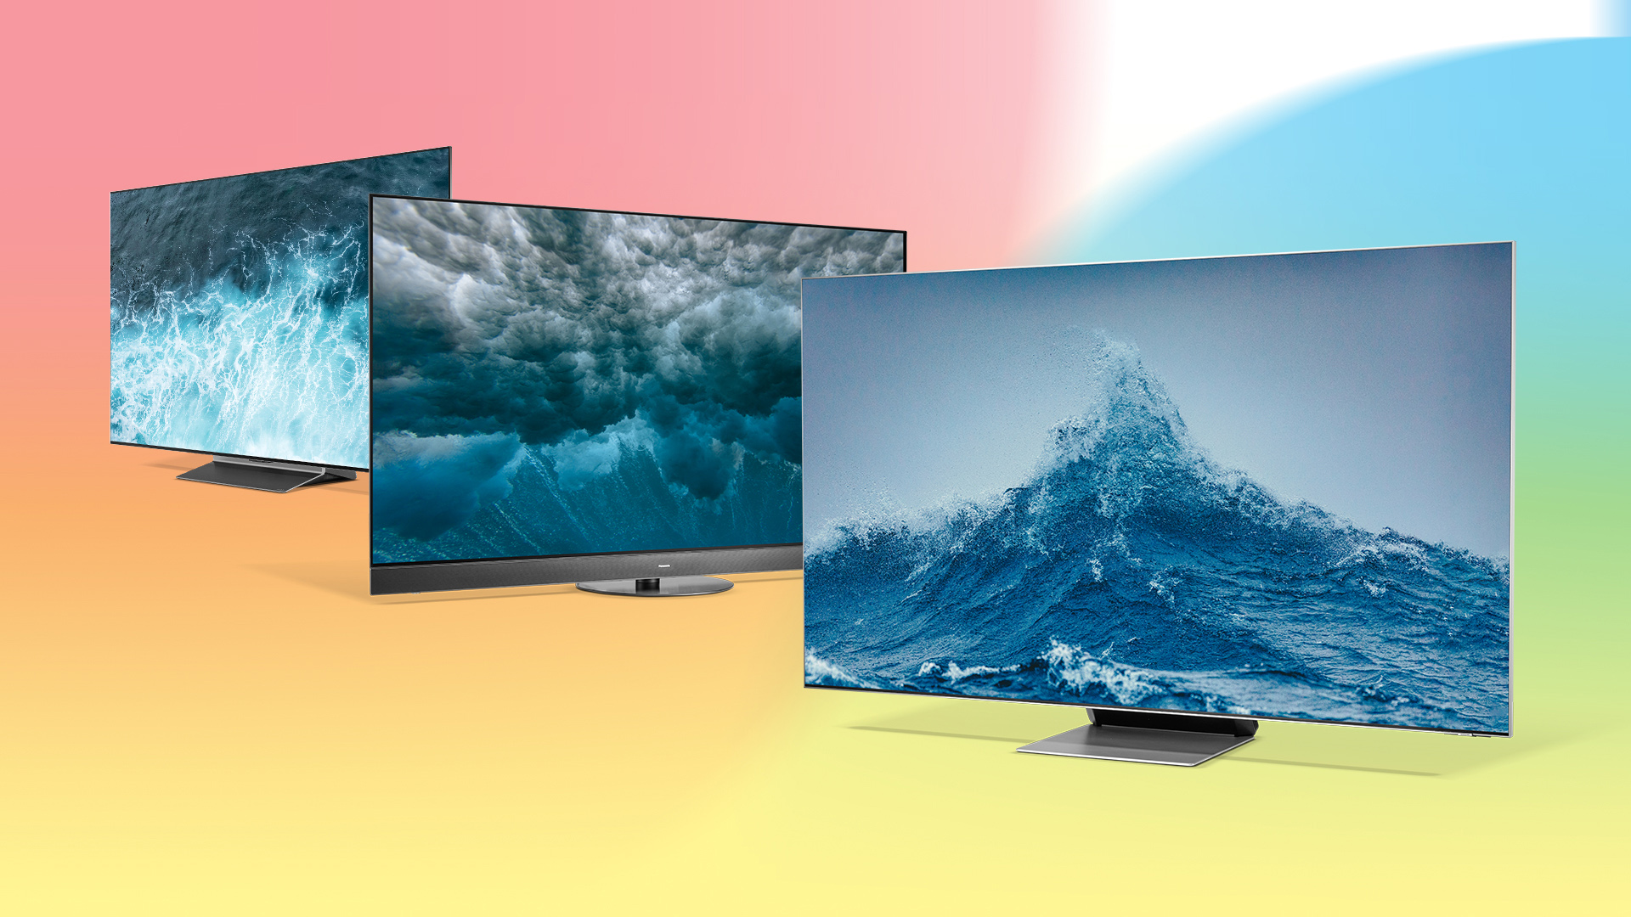
Objective of the Project :
Identify best-selling brands, price segments, and feature preferences to stock the right products

Slide 5

Libraries Used:
Regular Expressions
BeautifulSoup
Numpy
Pandas
Matplotlib
Seaborn

Slide 6
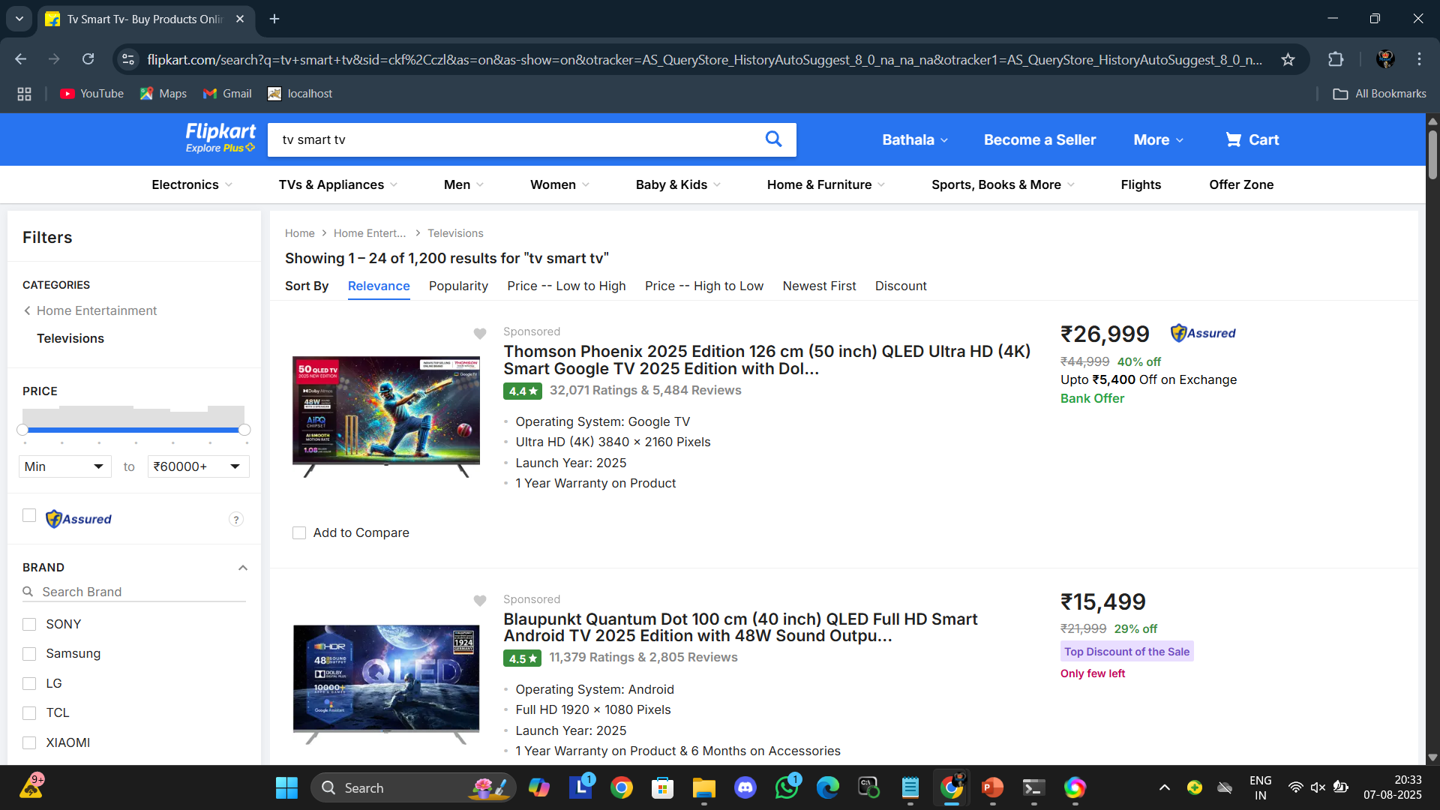
Web Scraping Details :
https://www.flipkart.com/search?q=tv+smart+tv&sid=ckf%2Cczl&as=on&as-show=on&otracker=AS_QueryStore_HistoryAutoSuggest_8_0_na_na_na&otracker1=AS_QueryStore_HistoryAutoSuggest_8_0_na_na_na&as-pos=8&as-type=HISTORY&suggestionId=tv+smart+tv%7CTelevisions&requestId=fe563320-2c7f-4939-8146-fdf487507768

Slide 7
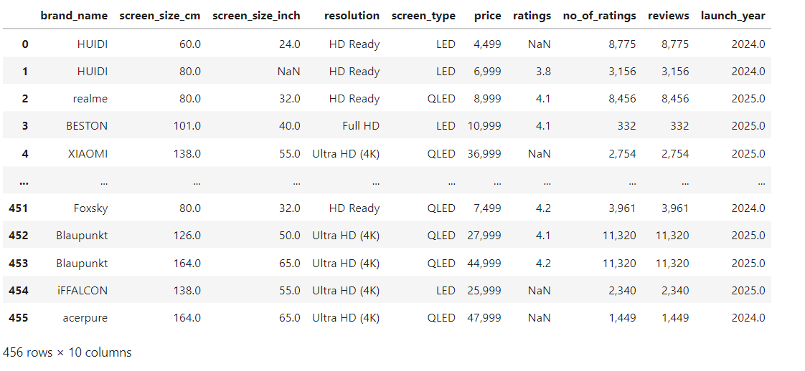
Raw data from website :

Slide 8
Summary of the Data :
Scraped 408 Data Points and 10 columns
Found total of 17 Null values in 3 columns.
Converted data types of several columns accordingly.
Collected Brand, Prices, Ratings and various data

Slide 9
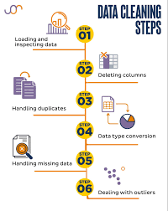
Exploratory Data Analysis:
Data Cleaning Steps :
Handling Missing Values
Handling Duplicates
Correcting Data Types
Handling Outliers
Fixing Inconsistent Formatting

Slide 10
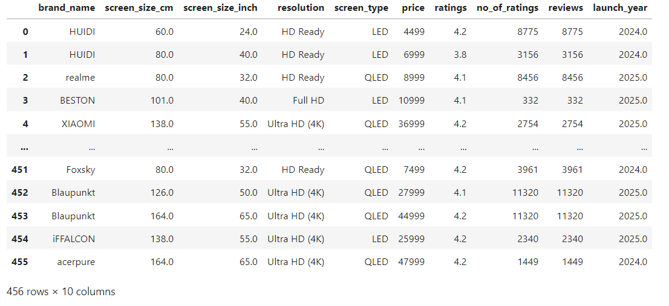
Cleaned Data Frame :

Slide 11
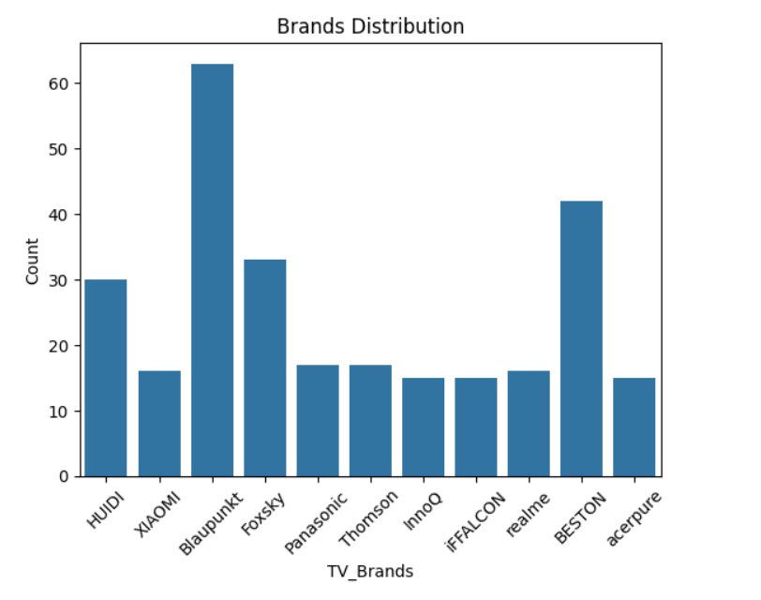
What is the market share distribution of different tablet brands?
the code generated a countplot it’s represent to the distribution of television brands in the dataset.
this type of plots is useful to understand the frequencies or count of each category in dataset. its provide a quick overview of brand distribution.

Slide 12
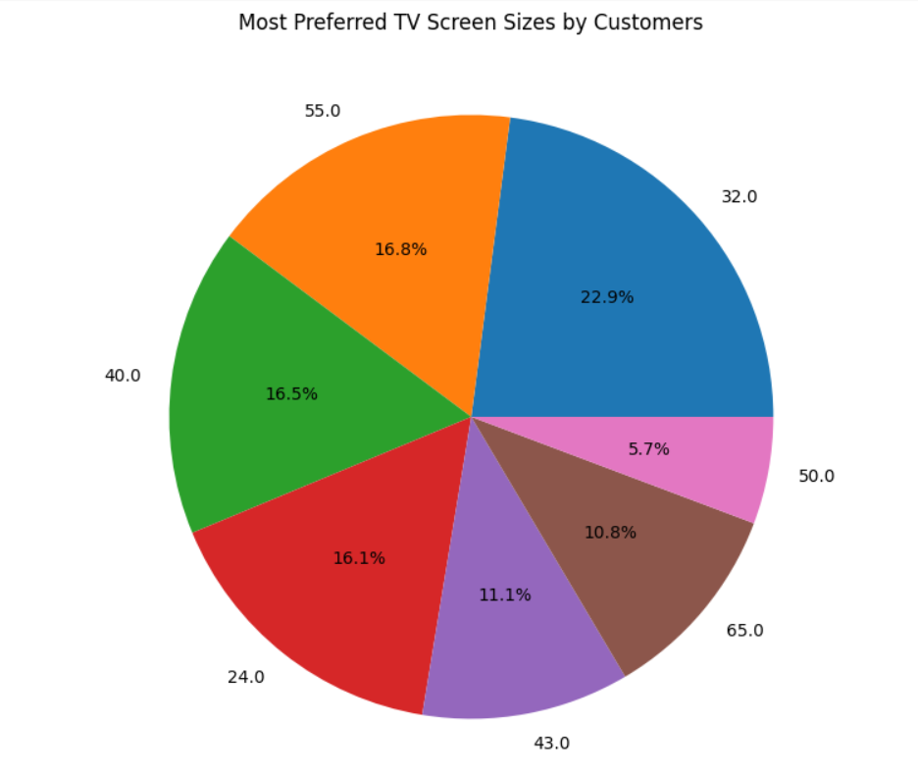
Which screen size has the highest customer preference?
This code aims to visually represent the most preferred screen size by the customers using a pie plot.
The top most screen size preferred by the customers is 32inch.

Slide 13
Bivariate Analysis Steps
1. Identify Relationship Between Two Variables
2. Choose the Right Visualization
3. Business Insights

Slide 14
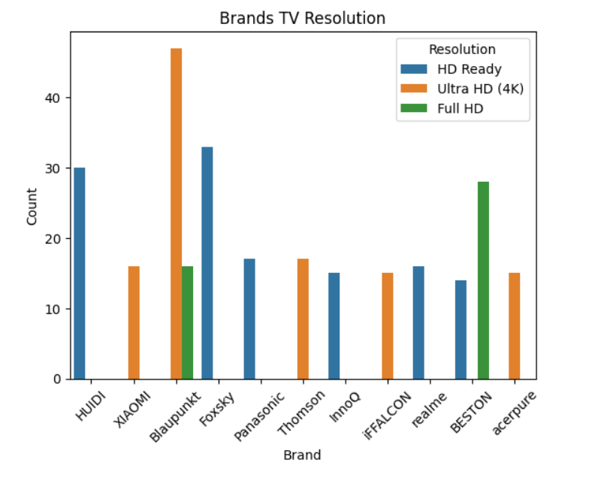
Which tv's brand, based on the resolution, appears to have the highest customer satisfaction?
The bar plot shows the count of TVs by brand and resolution.
Blaupunkt has the highest number of TVs, mostly with Ultra HD (4K) Ready resolution.
HUIDI and Foxsky are second highest number of TVs, mostly with HD Ready resolution.
Full HD models are rare and mainly seen for brands like Blaupunkt and BESTON.
•HD Ready is the most common resolution across brands.

Slide 15
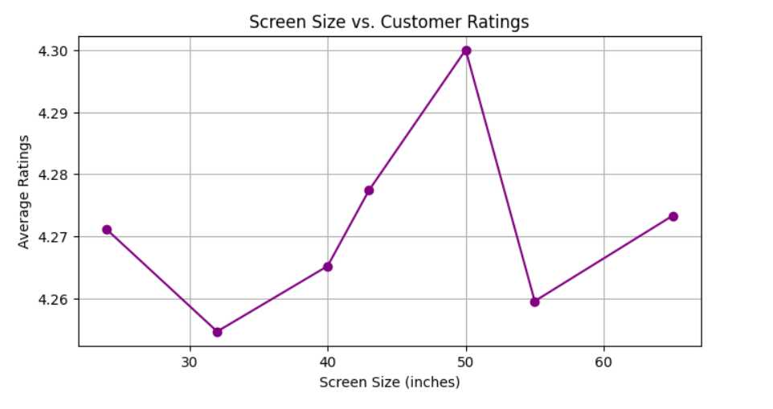
How do TV ratings vary by screen size ?
The plot shows the relationship between screen size and average customer ratings for TVs.
Customer ratings vary slightly with screen size, reaching the highest average rating at the 50-inch screen size.
The lowest average rating appears around the 32-inch screen size, while larger screens generally maintain higher ratings.

Slide 16
Multivariate Analysis Steps
1. Identify Relationship Between Two or more than two Variables
2. Choose the Right Visualization
3. Business Insights

Slide 17
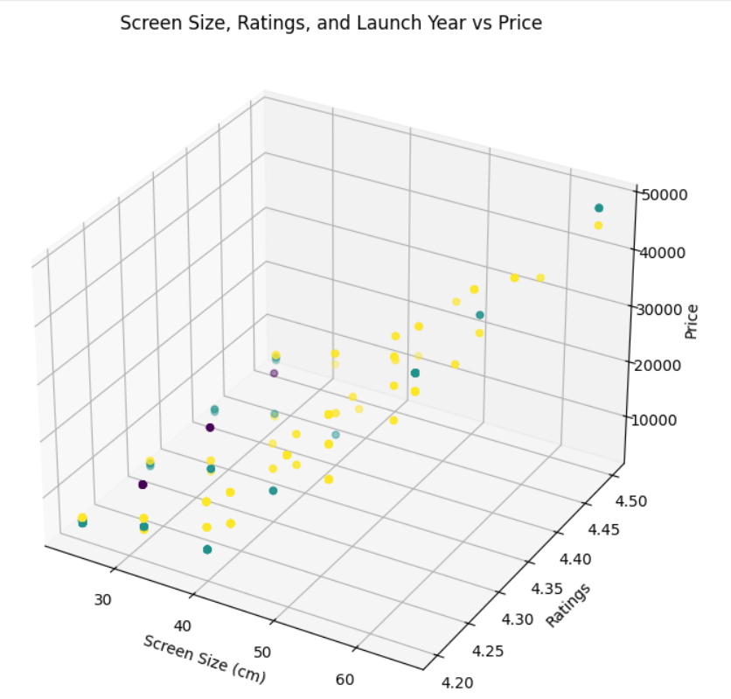
How do screen size, price, and ratings interact
The graph visualizes how TV screen size, ratings, and launch year (indicated by color) relate to price on Flipkart
Generally, larger screen sizes and higher ratings are associated with higher prices.
Newer TVs (in yellow) tend to be priced higher, reflecting better specs or newer technology.

Slide 18
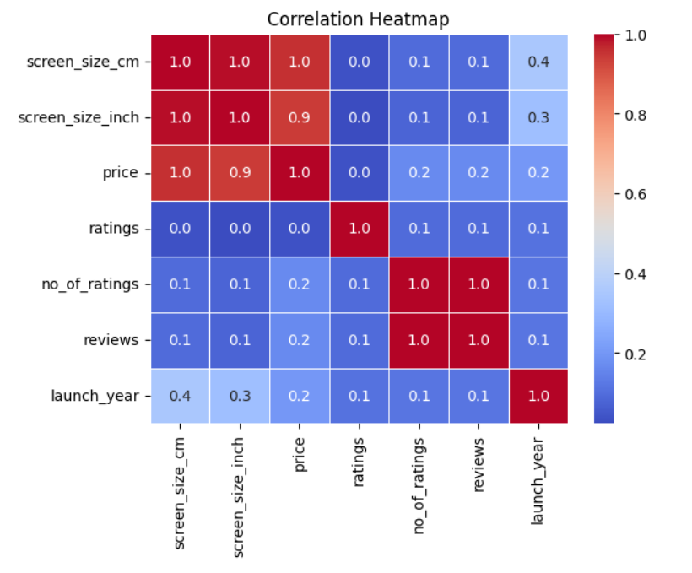
What are the correlations among numerical variables?
Screen size and price have a strong positive correlation (≈1.0), meaning larger TVs tend to be more expensive.
Ratings have very low correlation with price and other variables, suggesting user ratings are consistent across product types
Number of ratings and reviews are highly correlated (≈1.0), indicating users who rate also tend to leave reviews.

Slide 19
Conclusion
Most popular TVs are priced between ₹20,000 to ₹60,000.
Mid-sized TVs (32–40 inch) have the highest average ratings.
LED TVs are more common and affordable, while QLED TVs have slightly higher ratings but are pricier.
TVs with higher ratings attract more reviews, indicating a positive correlation between popularity and feedback.
Best value TVs are mid-sized, affordable QLED models with Full HD resolution.

